Slide 1
Brazilian E-Commerce DSBA 6160
Ornella Yema
Deevanshu Kishor Khatri
Tharun Kumar Bottlapally
Youlia Tzenova
Sravya Reddy Gangi
Sandhosh Murugasen

Slide 2



Use Case
Objectives
Develop a website which new or existing businesses can use in order to determine whether their products will be viable as an e-commerce offering in Brazil.
The website
The website would use existing data on Brazilian e-commerce in order to generate information which would help inform the user’s decision.
Functionalities
Generate a table of best-selling product categories in a particular state
Average price by product category in that state
Average number of months it takes a business in that state to reach its maximum number of orders
Population growth information by state to make business decisions

Slide 3
Basic Flow
Use case begins when user selects a product category or state from a drop-down menu
Selected state becomes filter in SQL queries
Business rule: state must exist in database & state must have orders associated with it
Selected product becomes the parameter for the GET_STATES function, which generates the state where that product sells the most
Business rule: product category must have more than 1 order in a given state.
Website generates two tables and three KPIs, corresponding to the following:
Top 10 product categories as defined by number of products sold: This gets generated by the query “Top 10 product categories in a state”
Average product price by product category
KPI: % of customer orders shipped to seller’s state
KPI: average number of months for a business to reach max orders
KPI: population growth percentage

Slide 4
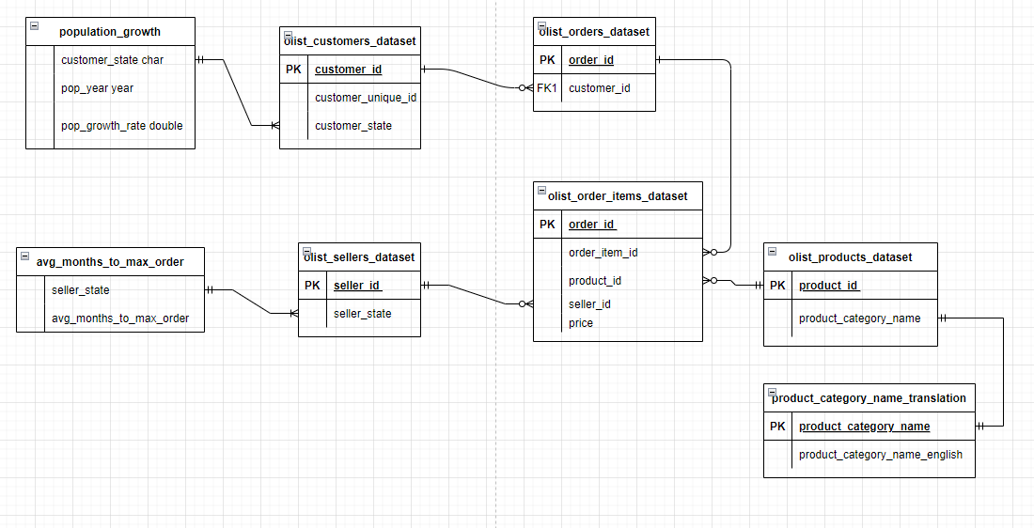
Simplify ERD Version
Tables: olist_customers_dataset olist_orders_dataset olist_sellers_dataset olist_order_items_dataset olist_products_dataset product_category_name_translation population_growth avg_months_to_max_order

Slide 5
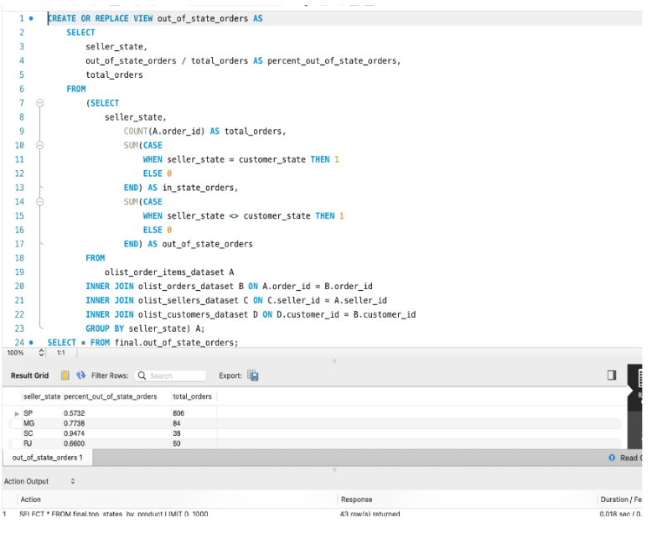
View 2 – out_of_state_orders includes conditional statements, nested query and group by This output is essential to our website because it shows States, Percentage of out of state orders, and Total Orders which helps our customers to determine how much they will be able to ship out of state.
Views

Slide 6
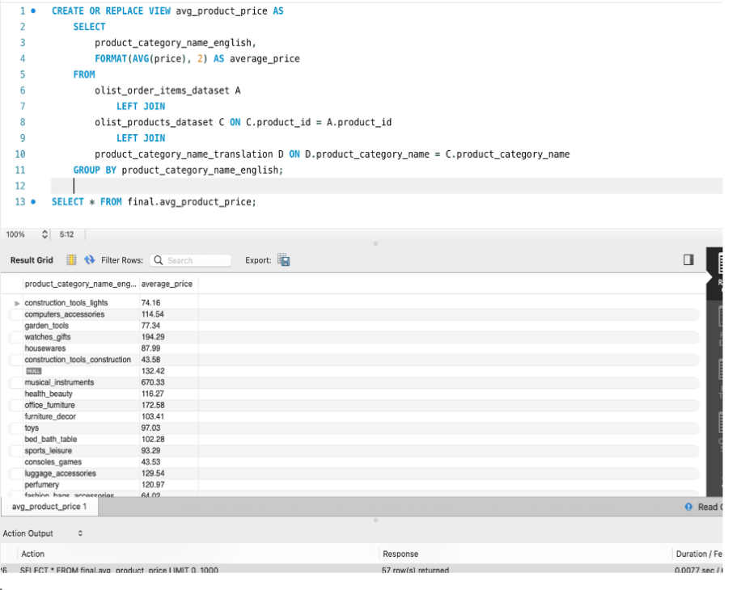
Views
View 3 avg_product_price includes summary functions and group by.
This output is essential to our website because it shows the average price of our product category.

Slide 7
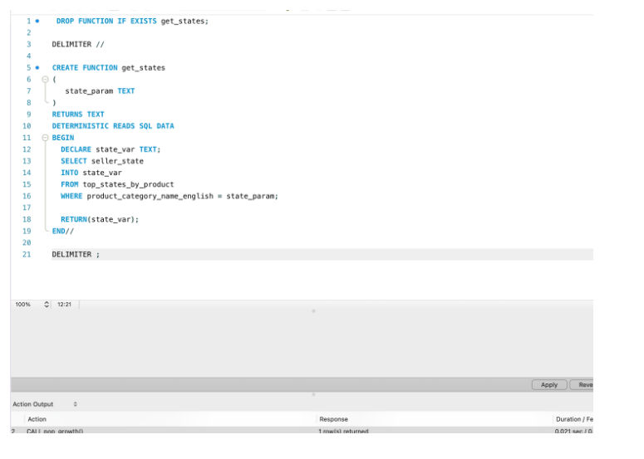
Functions
The function provides a succinct way to get a seller state without having to write a new select statement

Slide 8
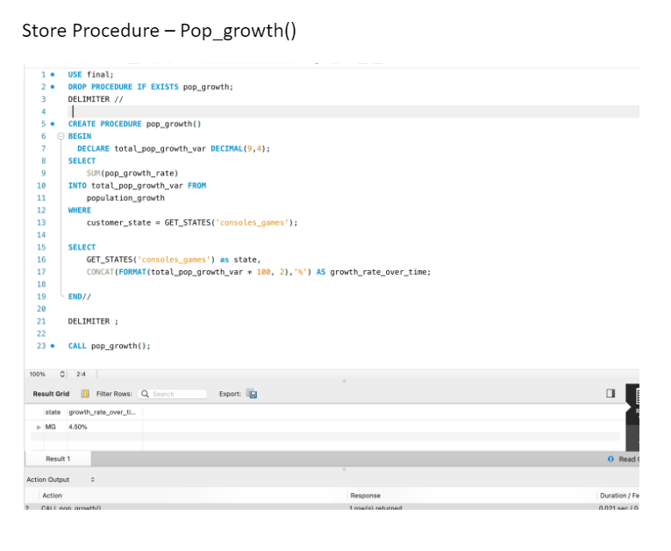
Stored Procedure
The stored procedure is important to our database because it stores the functions in the database, and it can be run anytime without having to write the same function all over again. Also, it provides security because the code is not modified after it is created and saved.

